Slide 1
Prediction models on diamond price
Zhenming Yang
932784300

Slide 2
Project description
Final project of CS 540
Finished with R language
Combined with crawler and data analysis
Compare four machine learning models

Slide 3
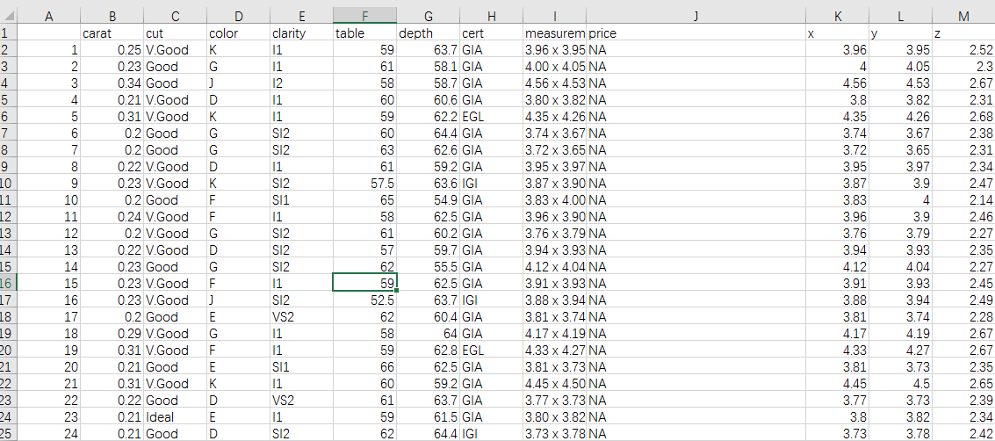
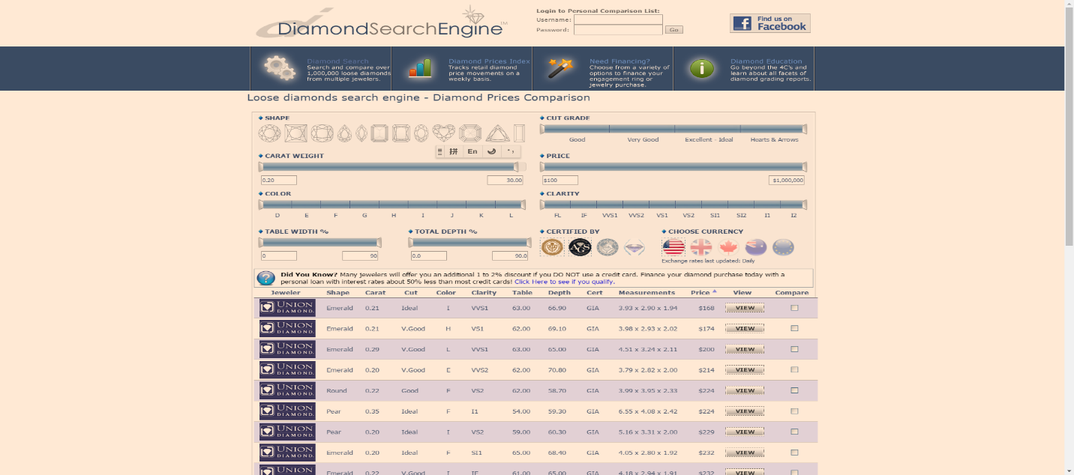
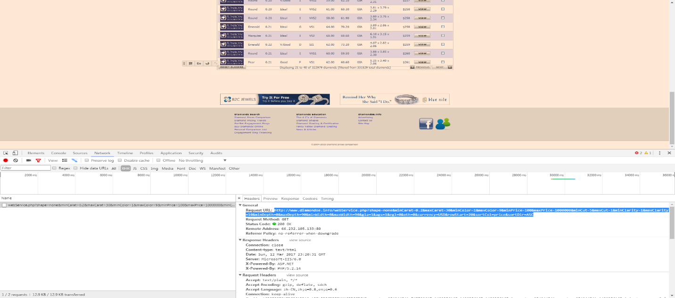
Source of data
All data from diamond search engine
http://www.diamondse.info/diamond-prices.asp
Analysis and collected with R crawler- rverst
More than 500000 round diamonds info collected

Slide 4
Source of data
Separate measurements in to x, y, z.
Omit NA and 0 values.
Price, carat, table,depth：Numerical variable
Shape: Round
Cut: 3 grades ( Good, V.Good, Ideal)
Color: 9 grades (D,E,F,G,H,I,J,K, L)
Clarity 10 (FL,IF,VVS1,VVS2,VS1,VS2,SI1,SI2,I1,I2)
Cert 9 grades( GIA, AGS, EGL,IGI,HRD,EGL USA, EGL INIFI, EGL ISRAEL, Others)

Slide 5
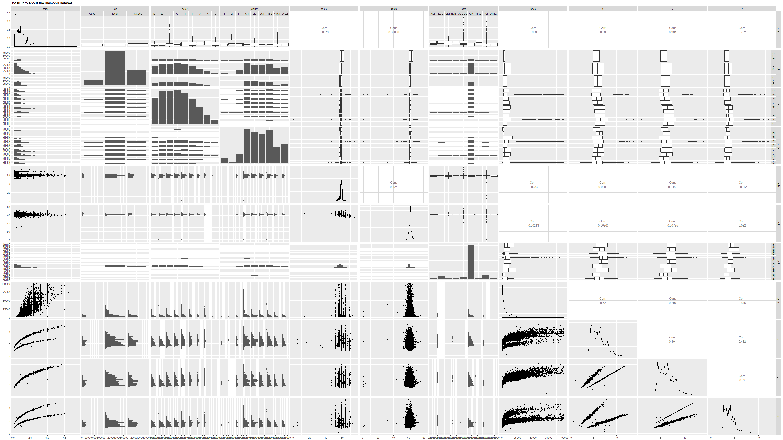
First step: general analysis

Slide 6
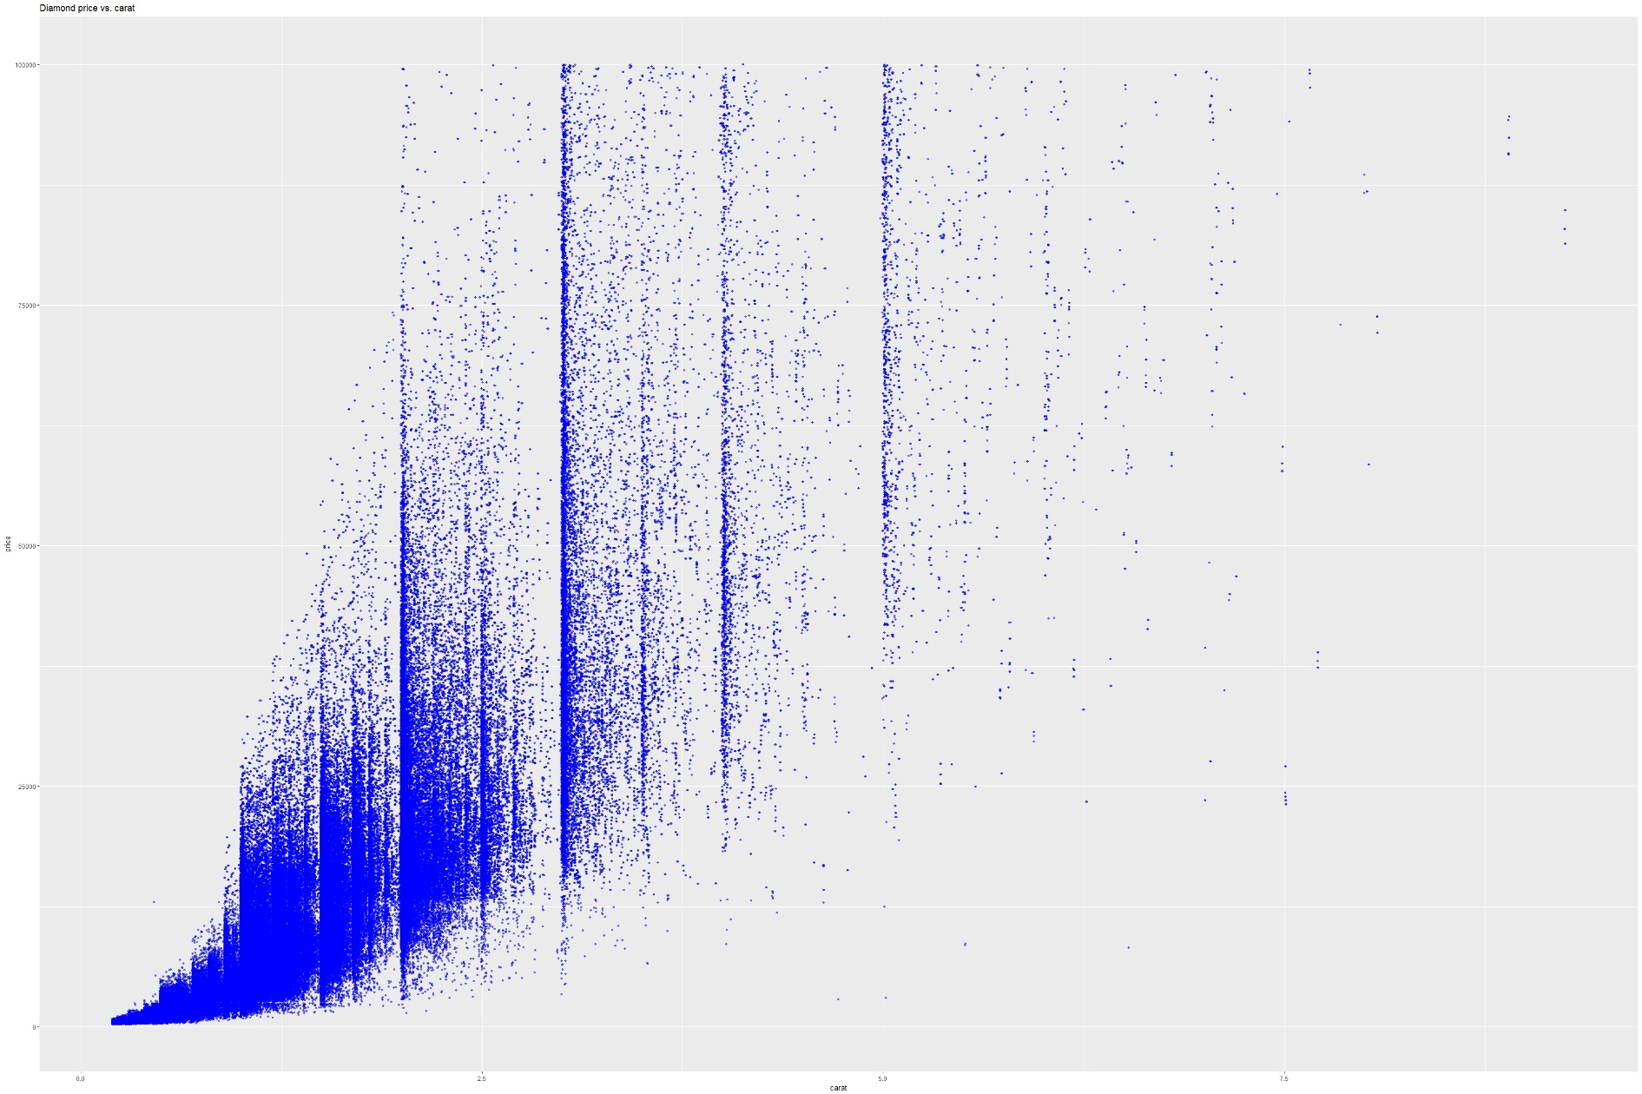
First step: general analysis

Slide 7
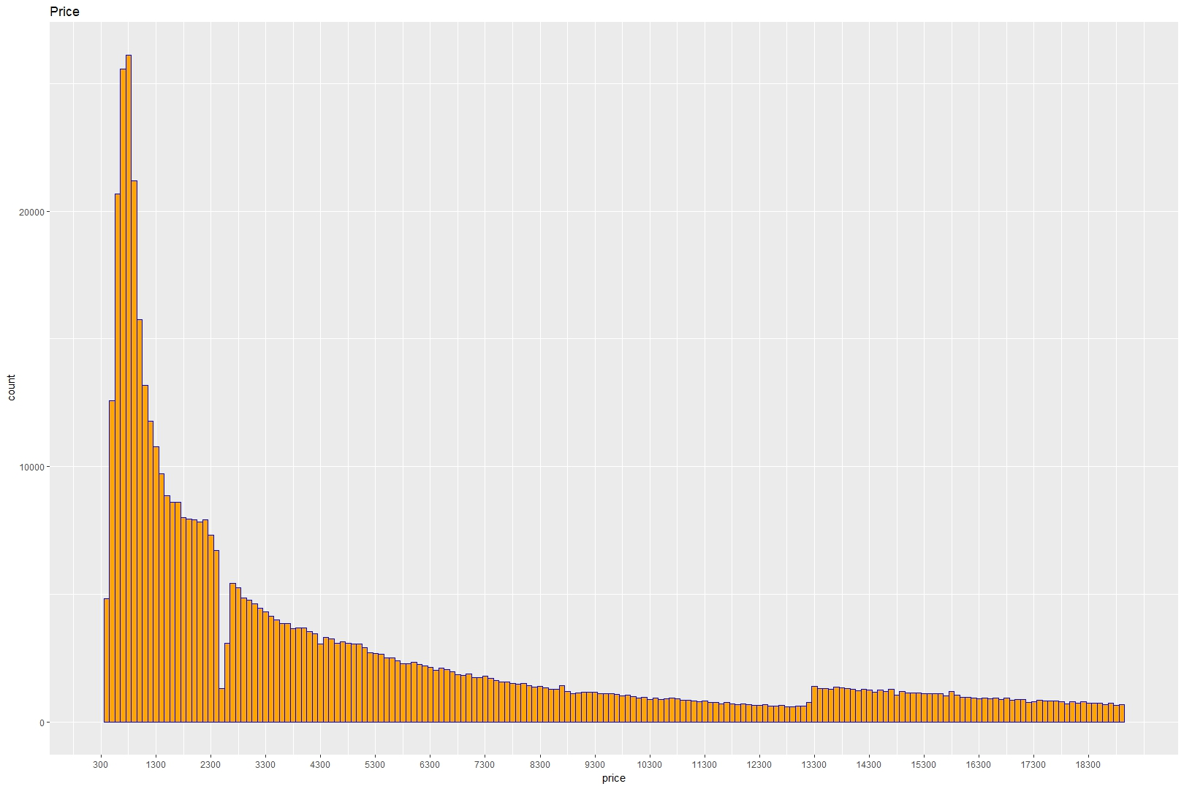
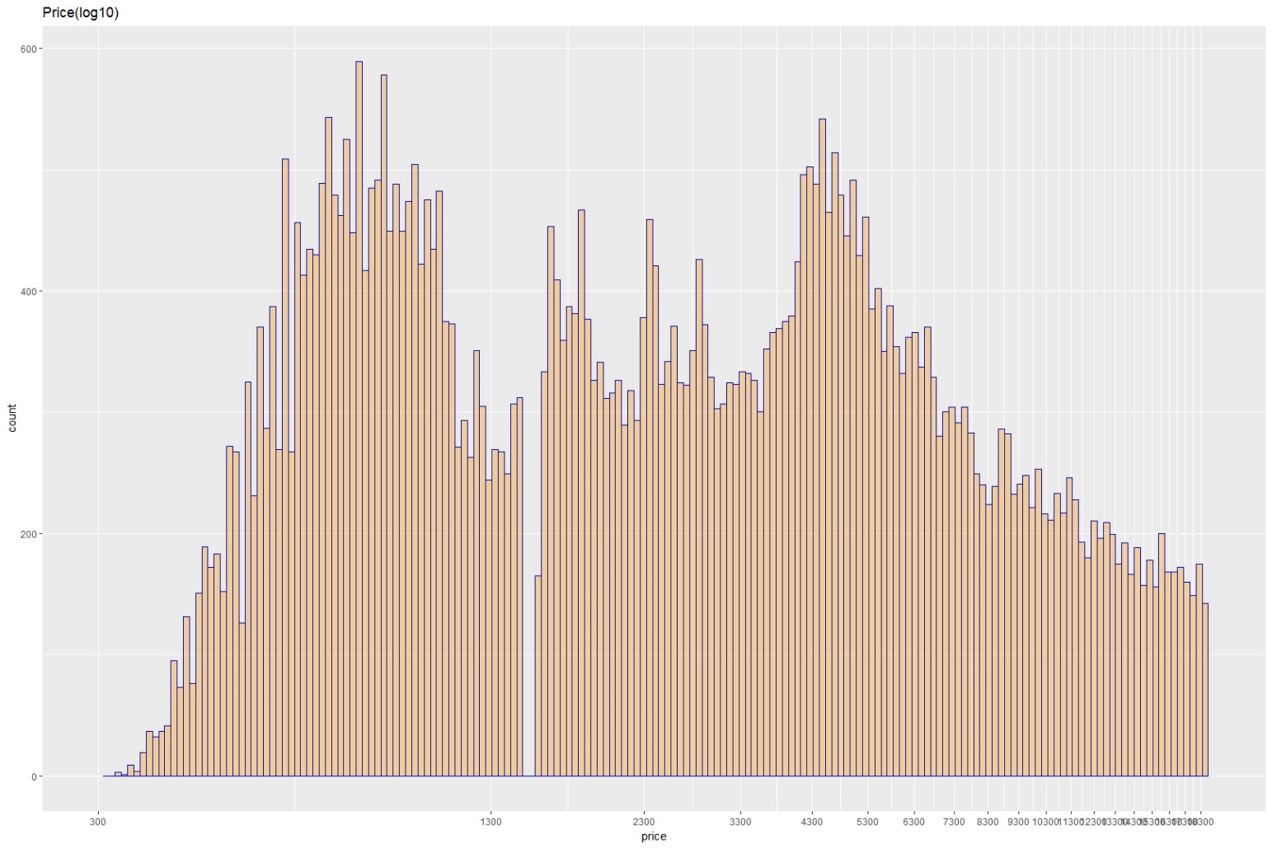
First step: general analysis

Slide 8
First step: general analysis
Notes:
Log10
In statistic, normal distribution is ideal and balanced is the least requirement
Most of data in real world follow the skewed distribution
One method to transform skewed distribution (Normality transform, Homogeneous transform and Inverse transform etc.)
Let the variance is constant, which volatility is relatively stable

Slide 9
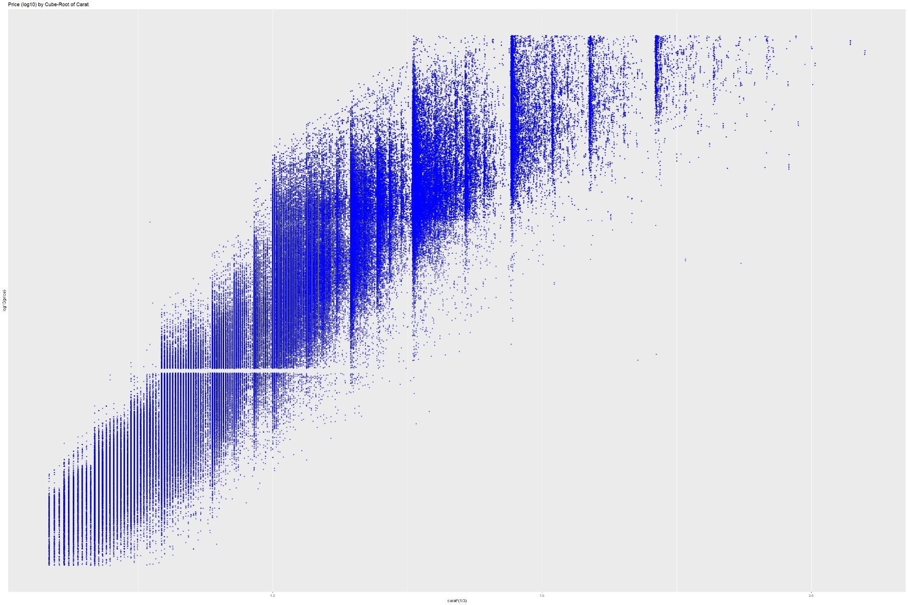
First step: general analysis

Slide 10
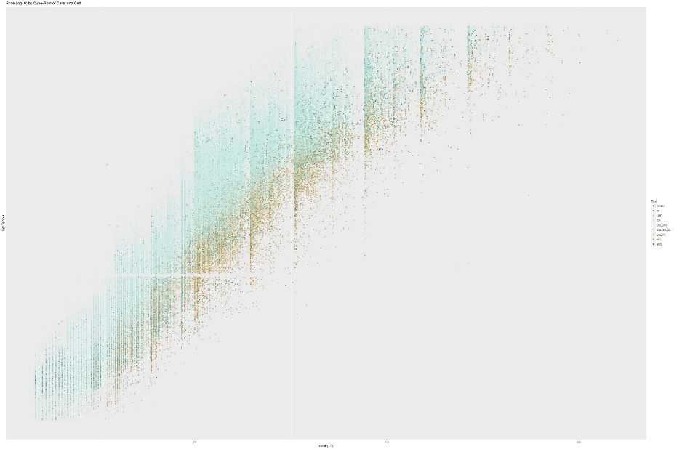
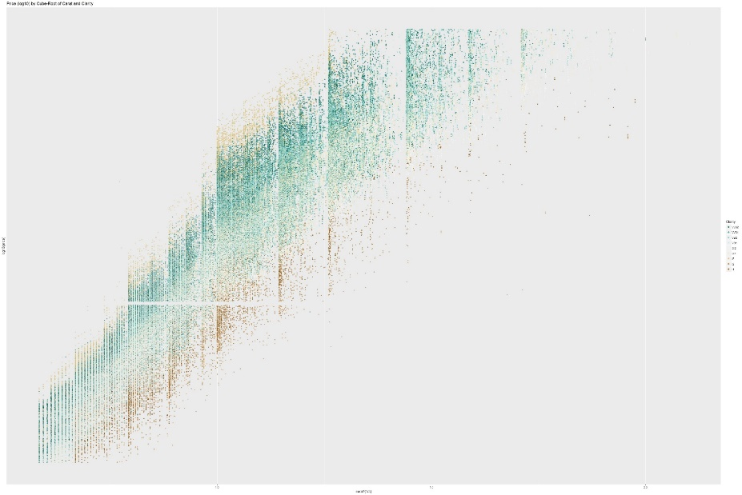
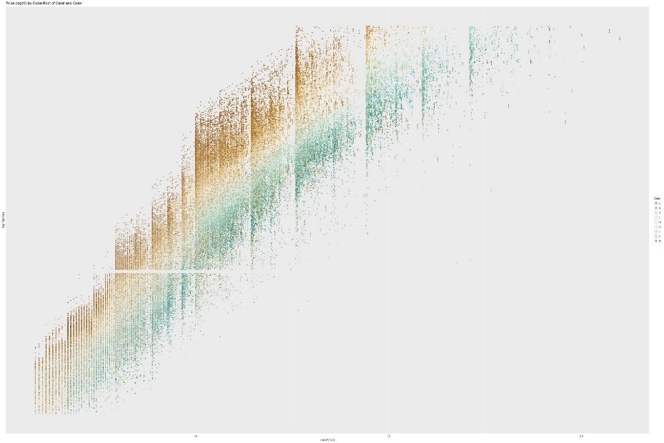
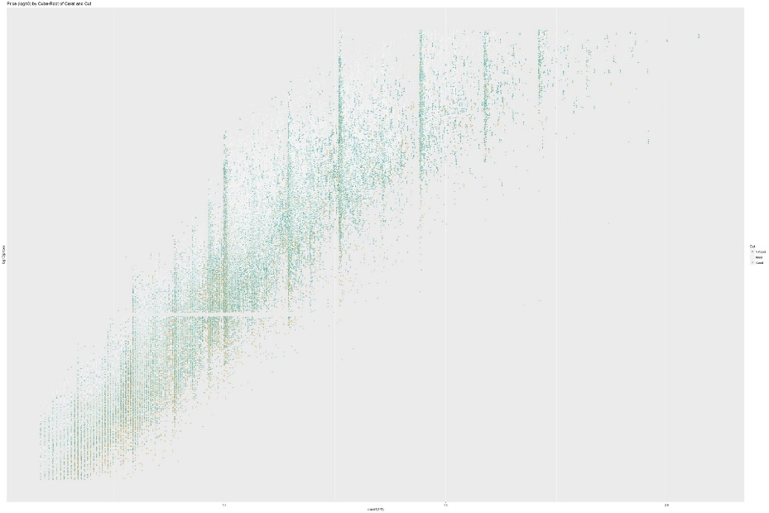
First step: general analysis
Clarity
Cert
Color
Cut

Slide 11
Model 1 : Multilinear regression
Is a linear approach for modeling the relationship among a scalar dependent variable y and one or more explanatory variables.
Often fitted using the least squares approach.
Step function used to optimized linear model
AIC value was used to determine model
Notes:
Linear regression models are often fitted using the least squares approach, but they may also be fitted in other ways, such as by minimizing the "lack of fit" in some other norm (as with least absolute deviations regression), or by minimizing a penalized version of the least squares loss function as in ridge regression (L²-norm penalty) and lasso (L¹-norm penalty)

Slide 12

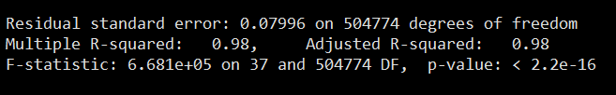
Model 1 : Multilinear regression
Basic model: lm1=lm(price~carat+cut+clarity+color+cert+table+depth+x+y+z, data=train)
Optimized model: lm2=lm(I(log10(price)~I(carat)^(1/3))+carat+cut+clarity+color+cert+table+depth+x*y*z ,data=train)

Slide 13
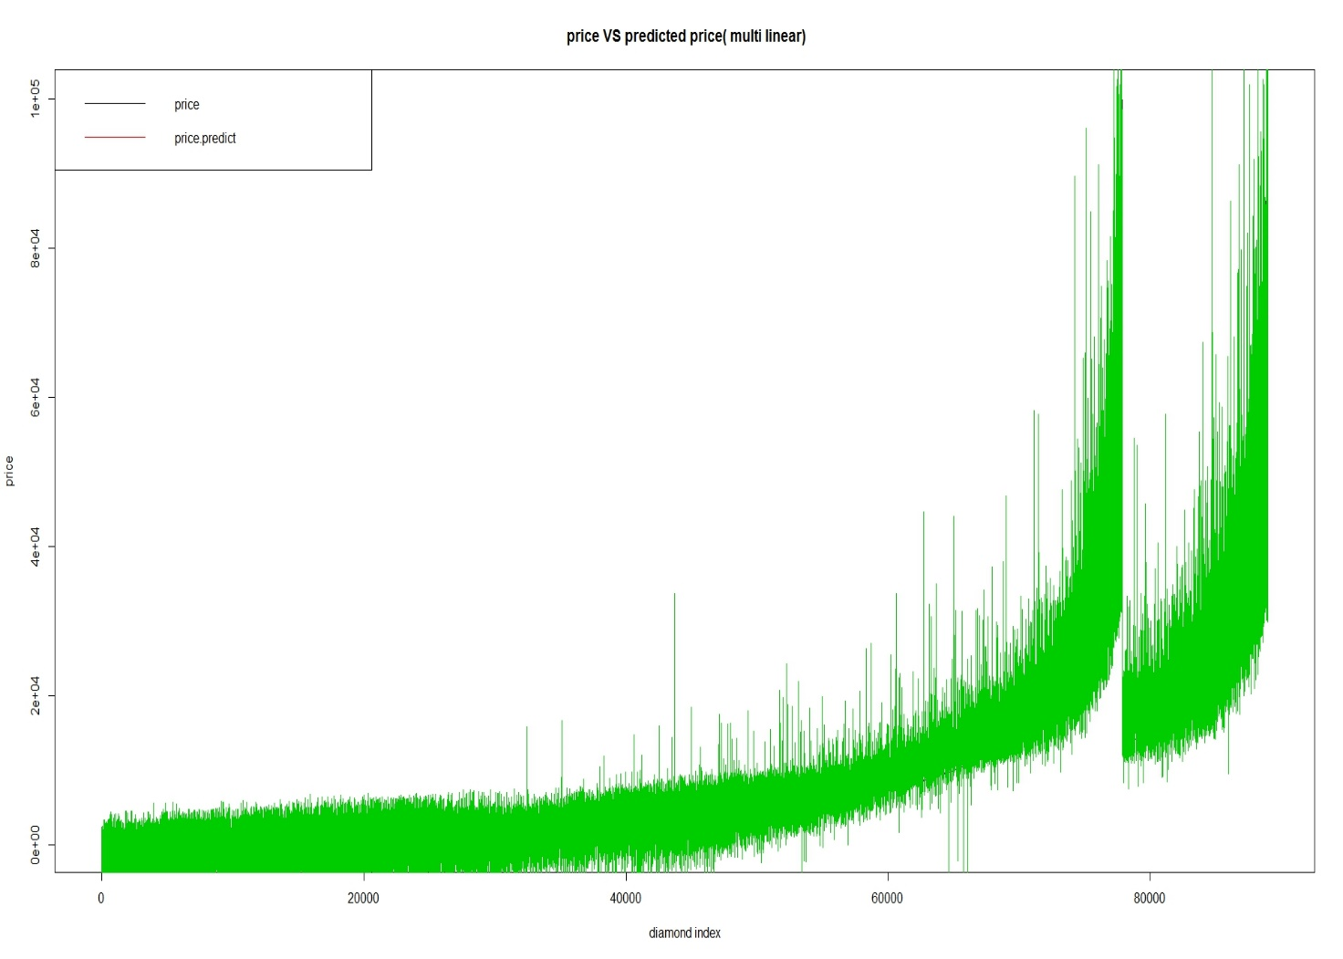
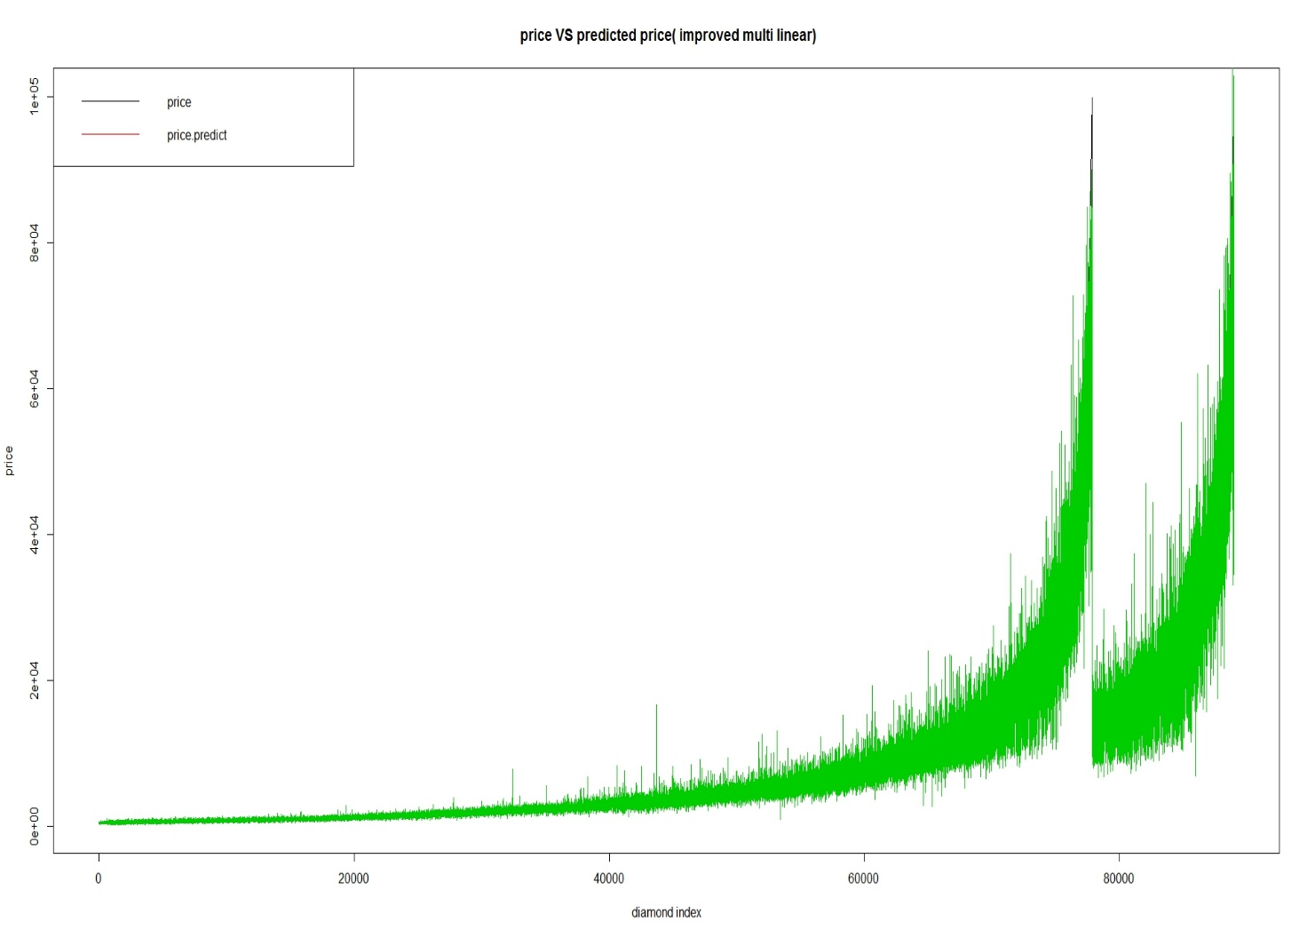
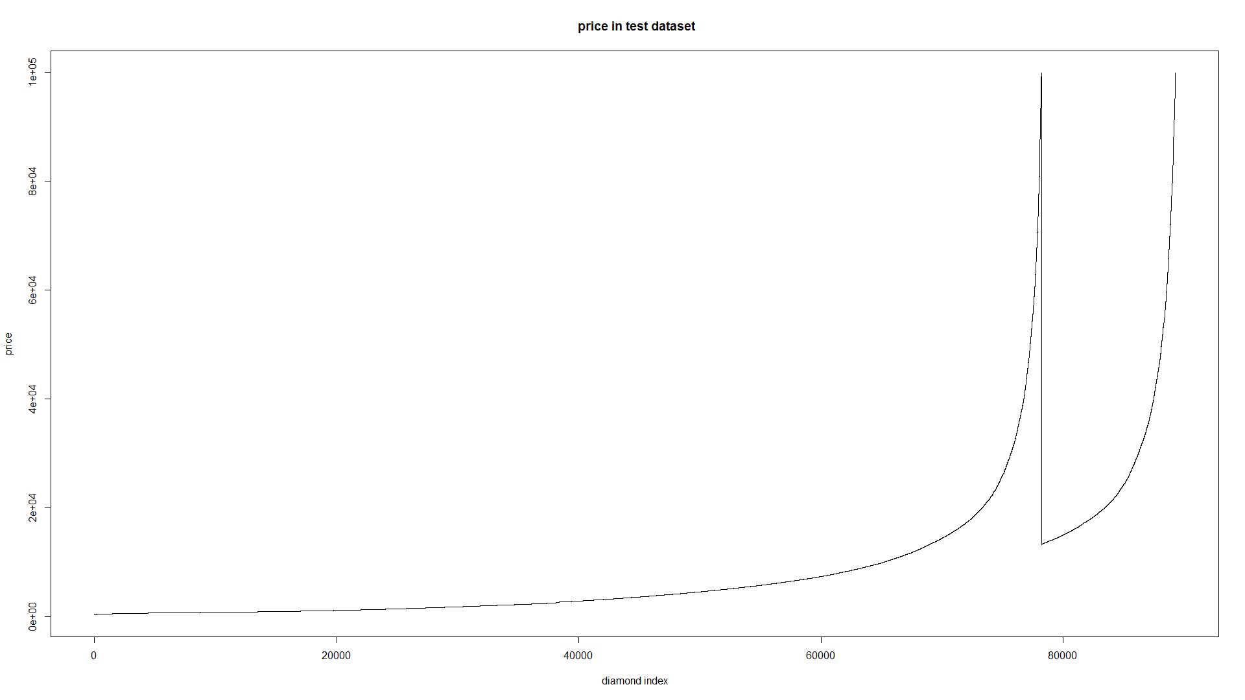
Model 1 : Multilinear regression
Step function used to move forward or backward to get a better model which has a better AIC value.(With the same p-value, a lower AIC value means a better model)

Slide 14
Model 2 : KNN
Is a non-parametric method used for classification and regression.
The output is the property value for the object.
Sensitive to local structure of the data.
KKNN: one knn implementation in R language
Basic parameters:
K :7（测试 5-10 的每一个数据）
Distance:2(Euclidean distance)
Notes:
The Akaike information criterion (AIC) is a measure of the relative quality of statistical models for a given set of data. Given a collection of models for the data,AIC estimates the quality of each model, relative to each of the other models.

Slide 15
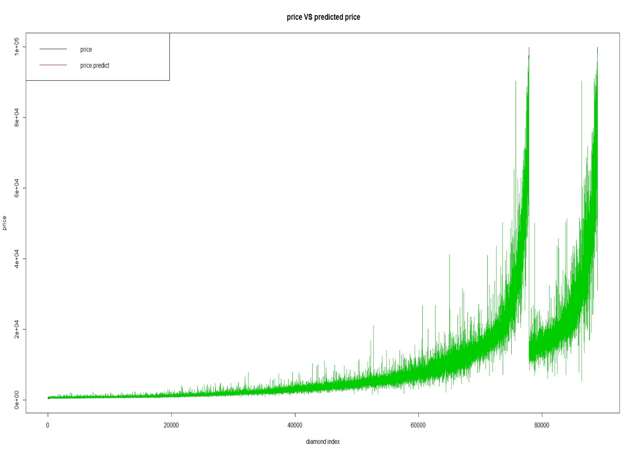
Model 2 : KNN
Basic parameters:
K :7
Distance:2 (Euclidean distance)

Slide 16
Model 3 : Random forest
One classifier with multiple regression trees
Random regression forest correct for regression trees’ habit of overfitting to their training set
Ranger, implemented as in the original Random Forest(Bremian 2001)

Slide 17
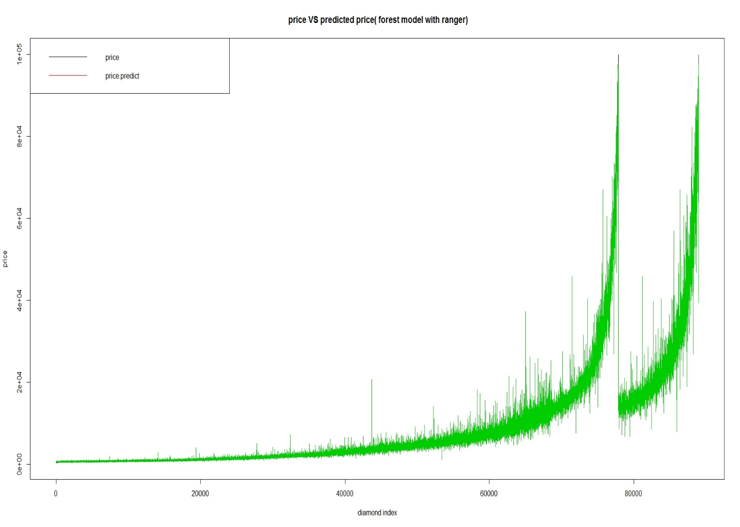
Model 3 : Random forest
Basic parameters:
Num.trees:600
Mtry:3
Num.thread:8
Splitrule: variance
Classification: FALSE

Slide 18

Model evaluation
MAE(Mean absolute error):
$$MAE=\frac{1}{n}\sum_{j=1}^{n}{\left|y_{j}−\hat{y_{j}}\right|}$$
MSE(Mean squared error):
$$MSE=\frac{1}{n}\sum_{i=1}^{n}{{\left(y_{i}−\hat{y_{i}}\right)}^{2}}$$
RMSE(Root mean squared error):
$RMSE=\sqrt{\frac{\sum_{1}^{i}{{\left(y_{i}−{\hat{y}}_{i}\right)}^{2}}}{n}}$
 | MAE | MSE | RMSE
Multi linear Regression | 1304.141 | 0.00956 | 0.06692
K-nearest neighbor
Random forest | 506.0266 | 1608895

